Slide 1
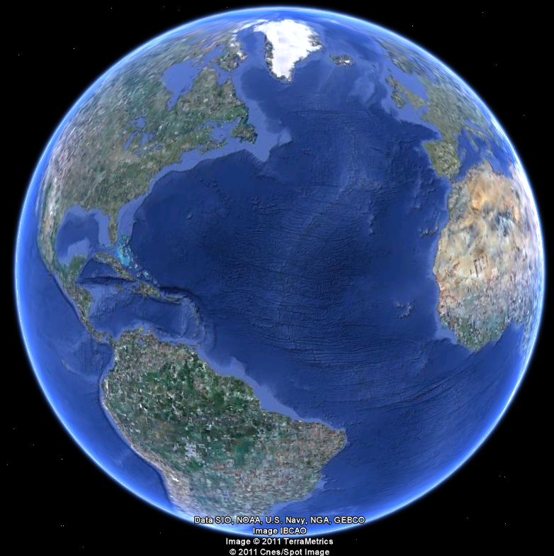
APEC 100 Sustainable Development
Food Production Around the World

Slide 2
Food Production: Can We Grow Enough?
Malthus (1798) underestimated role of technology in solving food scarcity problems. Improved production came from:
Crop varieties
Irrigation techniques
Pesticides
Better tillage methods
Fertilizer
Better animal husbandry
80,000 plants in the world are edible to humans.
Approximately 30 crops provide more than 80% of the world food supply.
Wheat, rice, corn, and potatoes >50% of world food production.

Slide 3
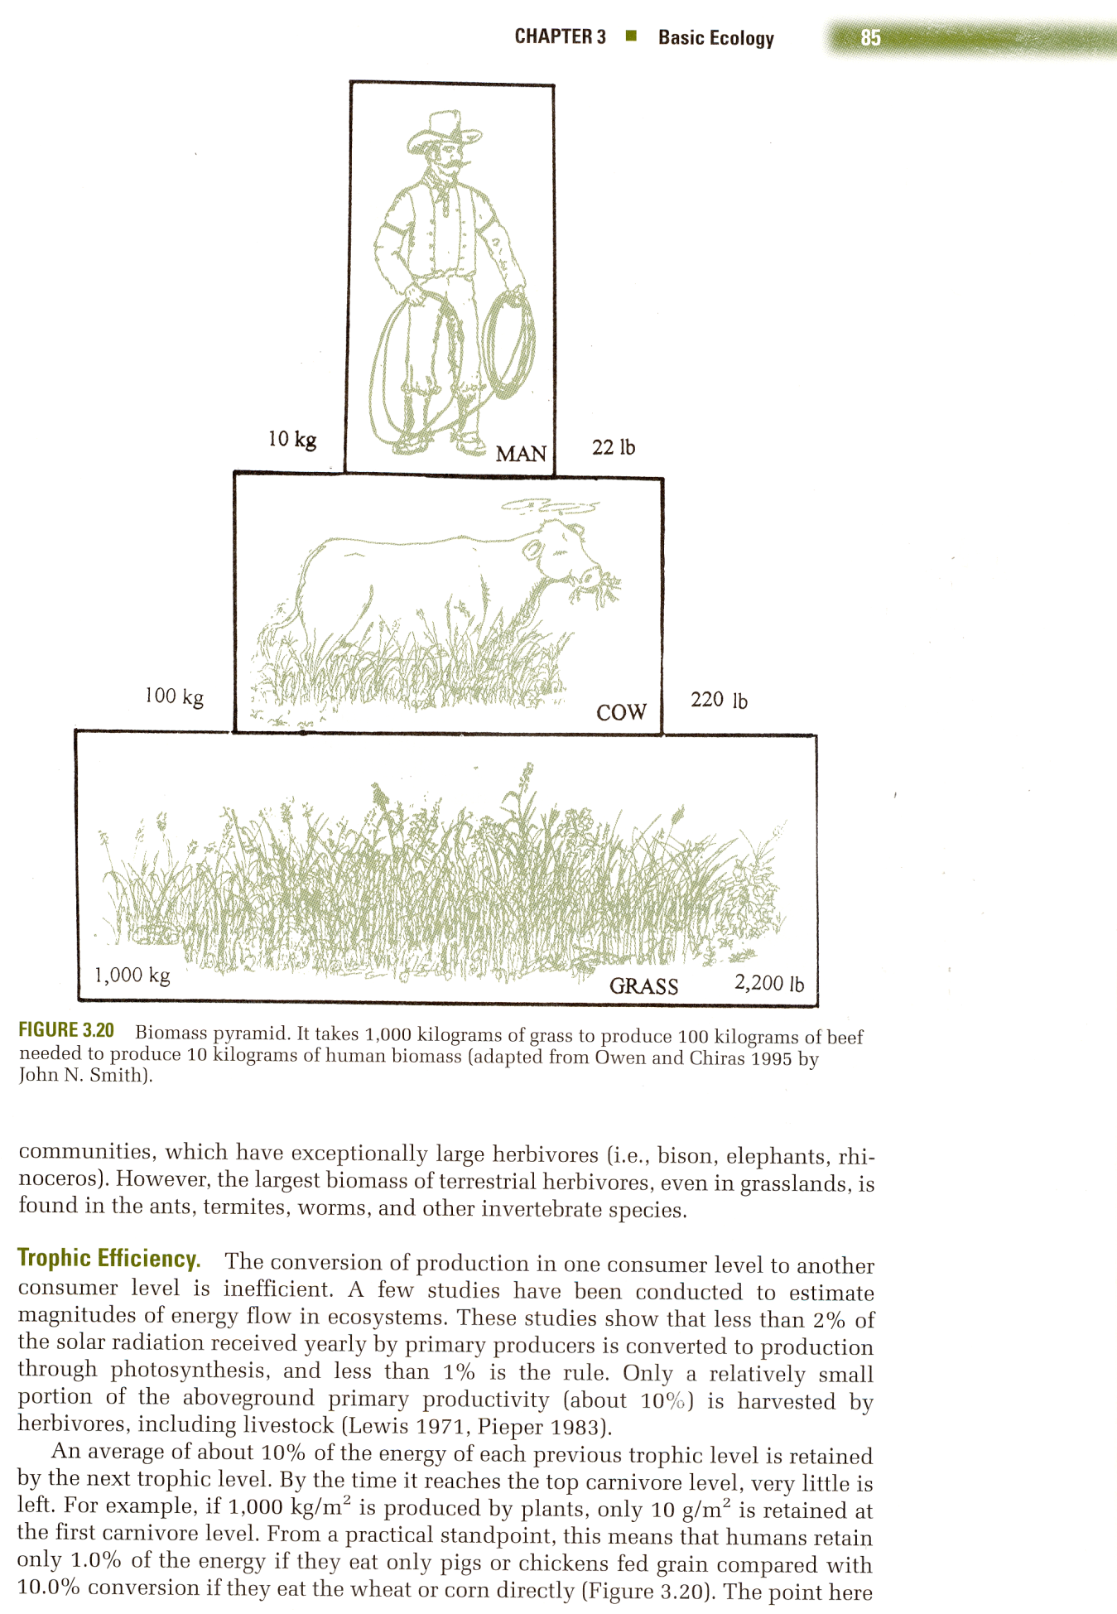
Trophic Efficiency
“The world can feed far more humans if they eat only plant material than if they eat a large amount of meat”
10% of the energy of each previous trophic level is retained at the next level
1000 kg of grass produces, 100 kg of cow produces,
10 kg of humans (or energy)
Source: Owen and Chiras 1995; Holechek et al.

Slide 4
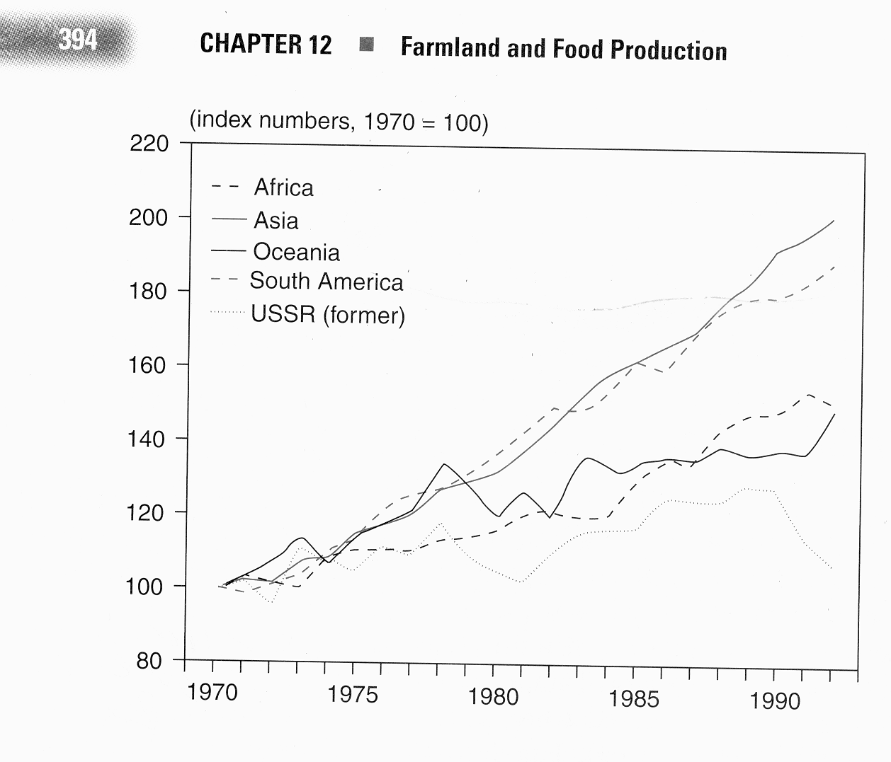
Global Trends in Food Production
Per capita food production +25% since mid 1970s.
80 million extra people per year.
Real price of food has fallen 10-30% since about 1980.
18% of world population (>1.1 billion) is undernourished.
Most in Africa and Asia
Food Production by Region

Slide 5
Quick History—Four Revolutions
1. Nomadic to sedentary populations
Domestication of wild plants 10,000 years ago
China, South America, Europe
Wheat, rice, corn, oats, potatoes
Permitted—Labor specialization, organized civilizations
2. 13th Century on—Exploration and Discovery
Accumulating knowledge
Trade, new plants and animals
3. 18th Century on—Industrialization
Technology of transportation, steam power
Farm mechanization after World War I
Large reduction in number of farms in U.S., marginal lands abandoned
4. Currently—Biotechnological breakthroughs
Improved crop varieties,
Fertilizers, herbicides, and insecticides
Hybrid crops

Slide 6
How to grow more food?
Bring more land into production
Increase yields on existing land
The Green Revolution
Since 1960. Norman Borlaug largely credited as founding father.
“Genetic selection of highly adapted plant varieties that are responsive to large inputs of inorganic fertilizer, pesticides, and irrigation water.”
Tougher, shorter stalks of wheat and rice—larger seed heads
3x to 5x increases in yields
Faster cropping allowed 2 or 3 crops per year

Slide 7
U.S. corn yields (bushels/acre)
(Source: Derived from data from USDA–NASS 2014).

Slide 8
Agriculture in Developing Countries
55% of world’s cropland is in subsistence agriculture
Subsistence farming techniques
Mostly, plots under 10 acres
Various crops
Family-owned plots
Animal power and “primitive” equipment
Intercropping
“Growing two or more different crops in alternative rows”
Combines high protein nitrogen fixing crops (soybeans) with nitrogen-depleting grains
Polyculture—Intercropping with many different plants
Agro-forestry—Intercropping with trees and a crop

Slide 9
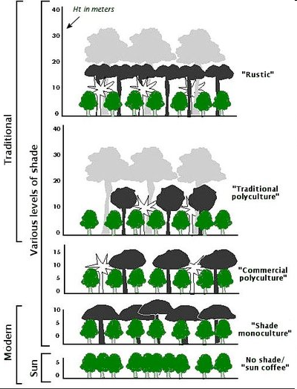
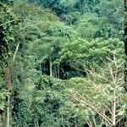
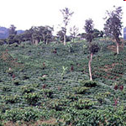
Ecosystem and Agro-Forestry Structure
“The spatial arrangement of the living and nonliving environment in a particular area”
Example—shade-grown coffee
Source: Patricia Moguel and Victor Toledo “Biodiversity Conservation in Traditional Coffee Systems of Mexico.” 1999. Conservation Biology 13:11–21.
http://nationalzoo.si.edu/ConservationAndScience/MigratoryBirds/Coffee/about.cfm

Slide 10
Agricultural Systems in Developing Countries
Industrialization
Specialized operators grow one crop or one animal
Mainly, developed world uses the industrialized agricultural system
Exceptions
Plantation agriculture in the developing world
Novelty farms in the developed world.

Slide 11
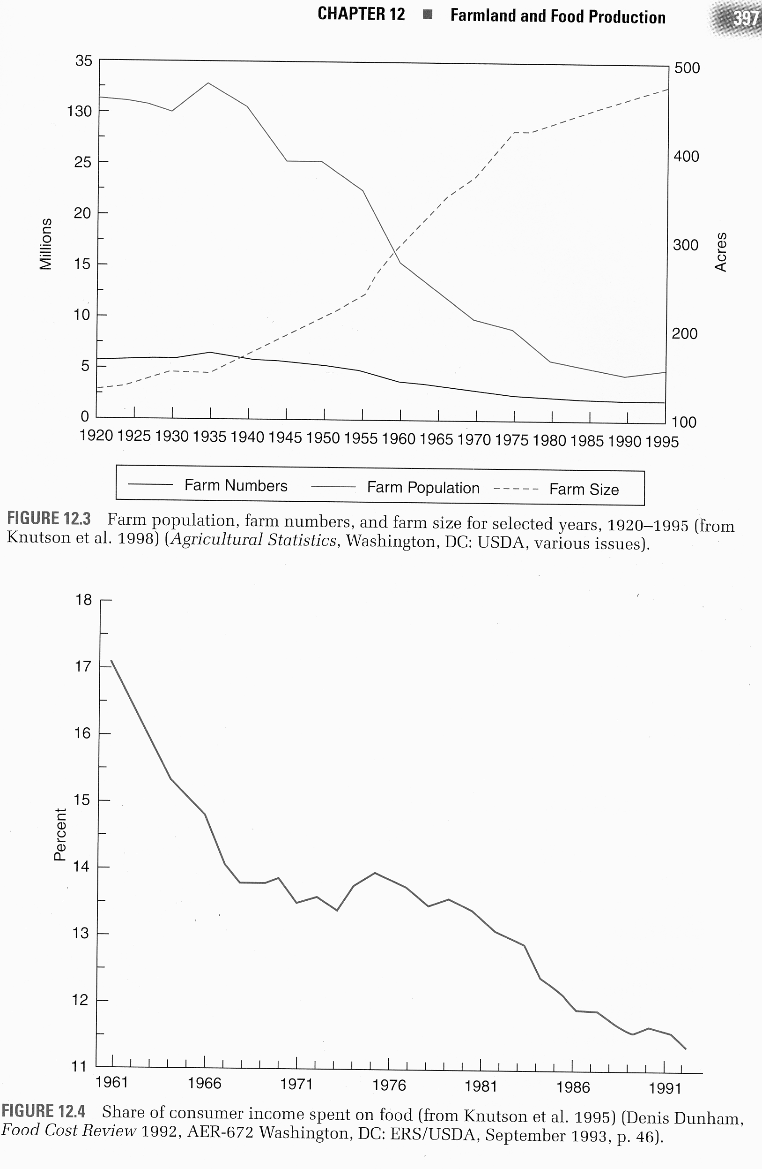
Less than 1% of workforce is engaged in farming in the United States
However, 20% of workers are involved in growing, processing, or marketing food (25 million people)
Agriculture is the largest industry in the US (in terms of total sales)
Number of farms
7,000,000 million in 1920
2,500,000 million today

Slide 12
Price Sensitivity of Agriculture
Agriculture is one of the most competitive industries
Demand for food is relatively inelastic:
Small increase in food supply (a good harvest) can leads to a large decrease in food prices
Good weather ➔ Abundant harvest ➔ Low prices
Bad weather ➔ Reduced harvest ➔ High prices
Dependent upon the global market and big producers
Such as corn and Iowa and the Midwest, wheat and the great plains, coffee and Brazil.
Also explains price increases in food due to ethanol production.
Percentage of consumer income spent on food:
U.S. 12%; World 40%

Slide 13
Challenges with US Agriculture
Increasing regulation
Use of pesticides, herbicides, tillage of soil, wetlands management, erosion
Protect the environment, but make U.S. products less competitive internationally
Non-point source water pollution
Concerns about food safety
Concerns about food production processes.
Lack of evidence-based policy on conservation programs.
Soil erosion
Access to water
Depletion of aquifers
Loss of irrigation water to urbanization
Production costs
Reliance on fossil fuels

Slide 14
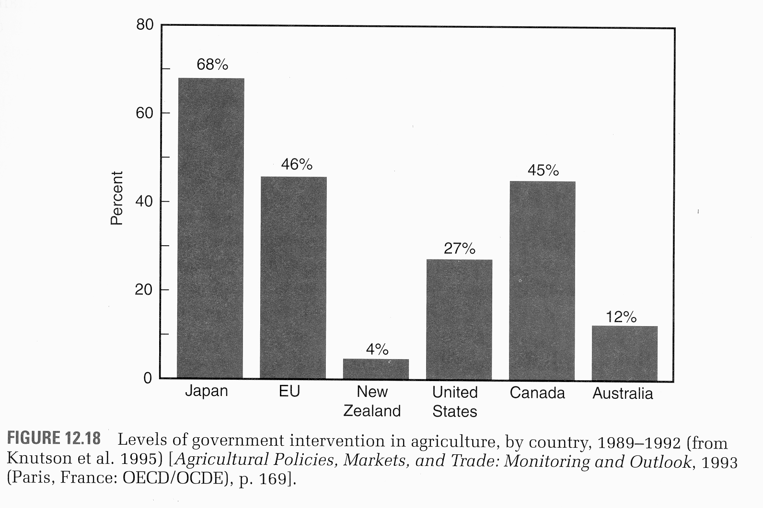
Farm Programs in Other Countries
Most developed countries provide more government subsidies than the U.S.
Maintain “healthy” farm sectors
Multi-functionality
Protectionist policies do not take advantage of one country’s ability to produce a product at a very low cost
Comparative advantage
Agricultural subsidies in the developed world often hurt farmers in the developing world.

